Slide 1
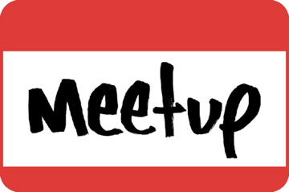
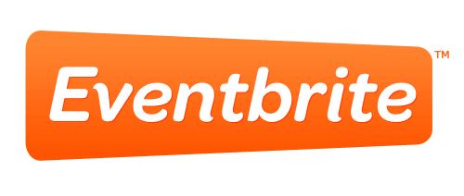
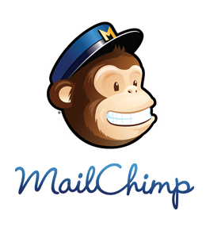
Welcome!
v

Slide 2
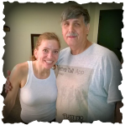
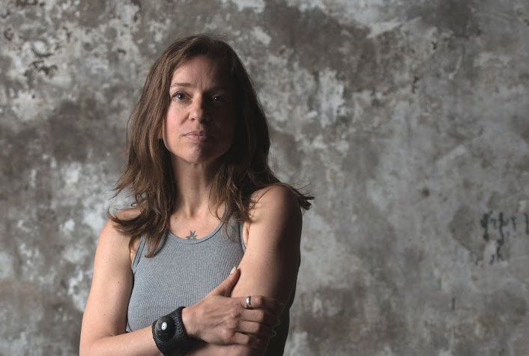
We Build Apps for Rock Stars!
Who are the Fustino Brothers?
Gary – Graphics & Business
Russ – Programmer and MVP
Rich – Musician & Content
Notes:
Gary, Russ, Gary

Slide 3
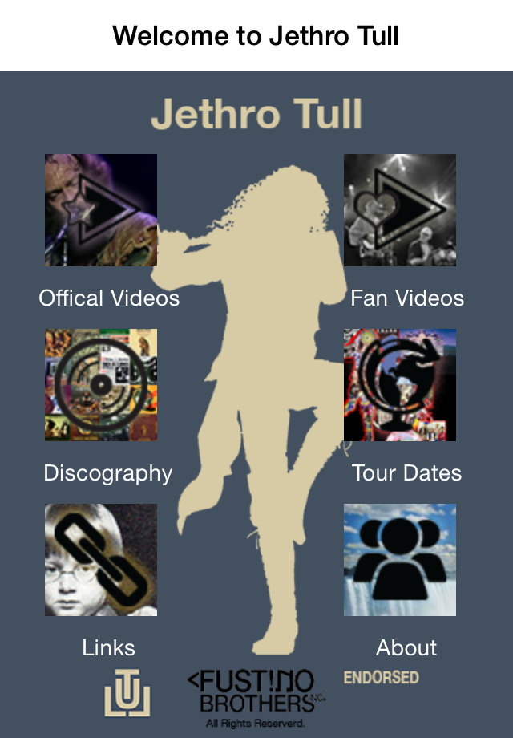
www.fustinobrothers.com/products.html
In All Popular App Stores
Notes:
Russ
This is the app, main menu, video and discography content and all the app stores
Tools - Use shared code. Xamarin, Unity, OutSystems, built on data driven engine
Monitize, ads, in app purchase, affiliate codes, and donations
Agreement with tull/ian Anderson – they endorse it and we manage the database of content
What do they get out of it, more tickets sales and music sales and merchandise, they do not want to be in the app business

Slide 4
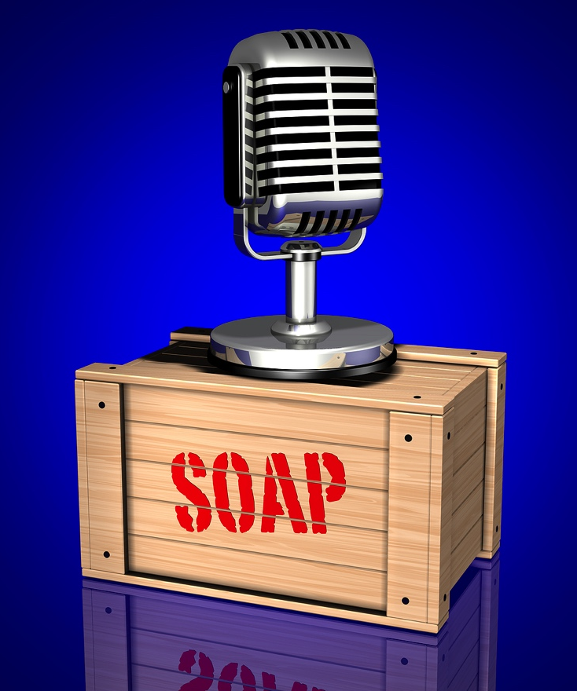
Now All About YOU!
(Your 15 Seconds of Fame)
Introduce Yourself / Your Business
What’s New or What’s Exciting?
Hot Projects – Published Masterpieces
Staff/Location Highlights
4

Slide 5
Topic…
Monetization Strategies for Apps Development and Social Media Marketing

Slide 6
Millions…
Monetization Strategies for Apps Dev & Social Media Mkg
There are millions of apps in all the app stores, with most being free. What does this do for your app monetization strategy?

Slide 7
Just the Facts Jack…
Monetization Strategies and User Experience
Free Apps are Installed More Frequently than Paid Apps
Monetization Models for Free Apps Can be Superior to Paid Apps
An Easier App Experience Makes it Easier to Make a Desired Purchase

Slide 8
That Work…
Monetization Strategy Scenarios
Advertising
Sponsorships/Endorsements
In-App Purchases
Donations
Freemium (trail and upsell strategies)
Affiliate codes
Subscriptions
Perk systems http://appsaholic.com/
Notes:
In app purchase – for upsells or related
Affiliate codes
Ads
Donation
Trail/free

Slide 9
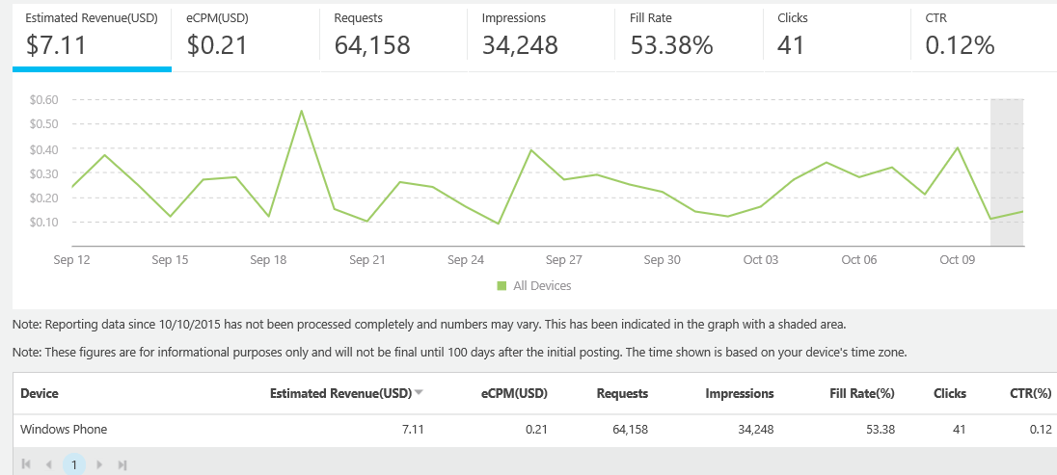
Pub Center…
Monetization Strategy - Advertising
Microsoft

Slide 10
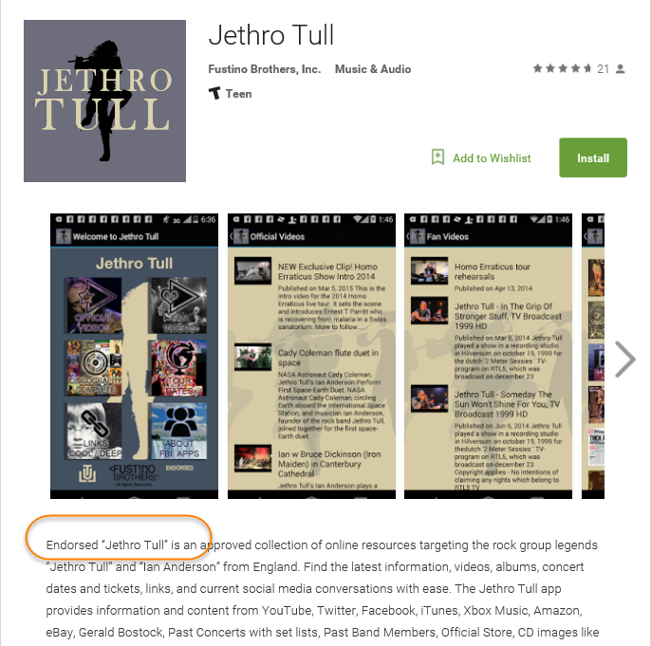
Endorsed…
Monetization Strategy – Sponsorships / Endorsements
Official

Slide 11
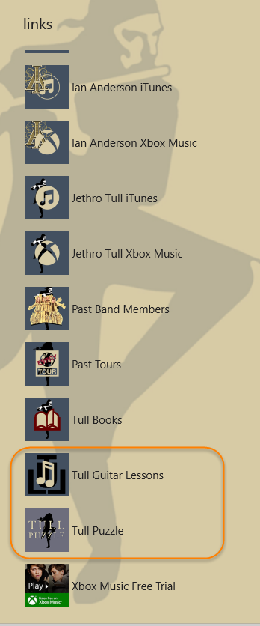
Buy Now…
Monetization Strategy – In-App Purchase
Links in the App

Slide 12
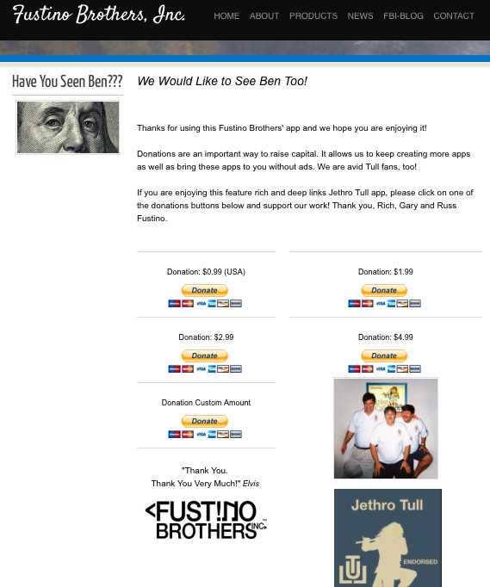
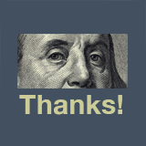
Donate…
Monetization Strategy – Donations
Thanks for Your Donation!

Slide 13
Examples…
Monetization Strategy - Freemium
Free Trial Strategy
More Videos
Analytics
More Features - Search - Song Lists - Direct Access to Songs - Live Show Streaming
Success Story – Thomas the Train

Slide 14
Examples…
Monetization Strategy – Affiliate Codes
Xbox Music
iTunes
Amazon
eBay

Slide 15
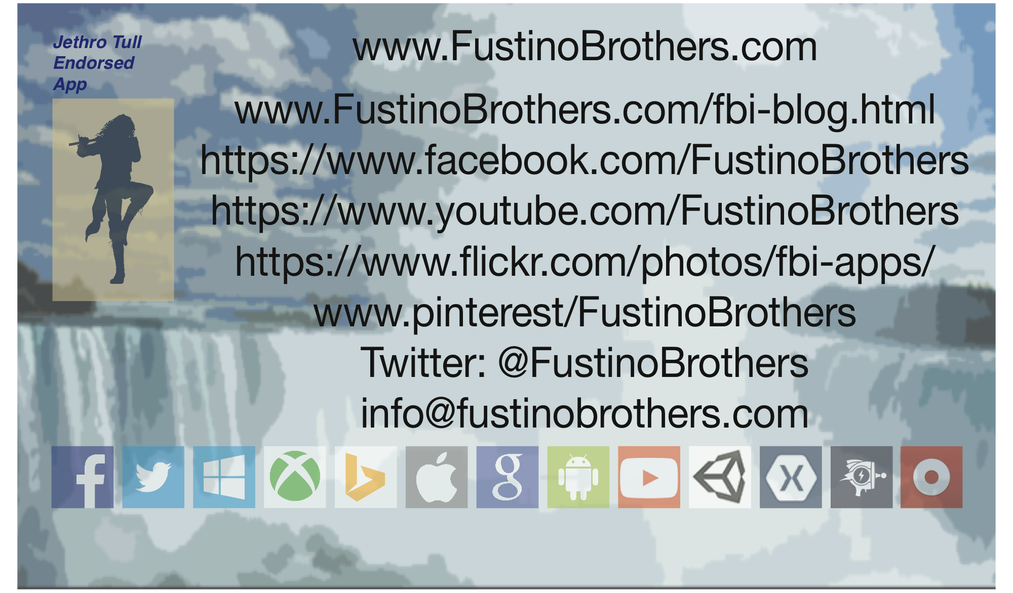
Connect Us Today.
Thank You!
Notes:
Gary
Questions
How made have you made $$ to date?
Not yet. But we have instrumented the code to determine exact usage. We need to do more analysis including in app purchases.
How many downloads?
A couple thousand
Who is your competition?
Not much. Only a handful of rock star apps, why? They don’t want to be in the app business. The Stones, Bon Jovi to name a few.
How do you test?
We have a team of testers assembled and error reporting tools
Who has Rich played with?
Billy Shean (David lee roth), Clint Holms, taught Ani DeFranco, James Piorkowski Music Professor University of Fredonia
How are revenue streams disjoined, consolidate music production houses. Not even all the albums are on their website.
Who is on our list?
Grateful Dead
Justin Timberlake
Jimmy Page
Deep Purple via Richey Blackmore
Martin Barre
Ani DeFranco
Temptations
David Lee Roth via Billy Shean
Gran Funk Railroad
ELP
Rick Darenger
Mike Fulkner - Guy that built stage software for Paul McCartney and Bruce Springsteen
Clint Holms

Slide 16
Join In – By Computer
At Your Computer- If Available Use a Headset
Enter This link:
https://www.startmeeting.com/wall/679-256-129
Click/Tap "Join”- - Complete your Name and eMail Address - Then "Submit” - The System will Guide from There - Mike Symbol Click/Tap the Green Icon to Red
Test your speaker/mike. If headset doesn't work, or if connection is lost - try "Rejoin”
16

Slide 17
Join In – By Phone
Join-In using a land line / mobile phone
Dial - (530) 881-1212
When prompted enter access code followed by the "pound" key.
679-256-129# (be sure to enter the "#" hashtag symbol)
17

